Slide 1
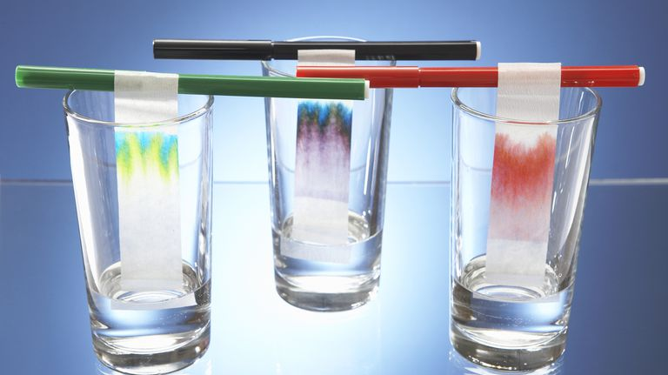
Paper and thin layer chromatography

Slide 2
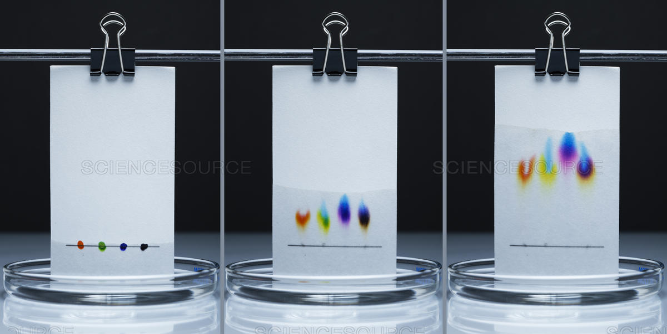
Introduction to Chromatography
Used to separate and analyse substances in a mixture
All methods of chromatography have a stationary phase and a mobile phase
A mixture is applied to one end of the chromatography system and the mobile phase is then allowed to pass through. The components then undergo a continual process of adsorption onto the stationary phase, followed by desorption and dissolving in the mobile phase.
The ability of a component to stick to the stationary phase will depend upon the nature of the intermolecular forces present in the component and the stationary phase

Slide 3
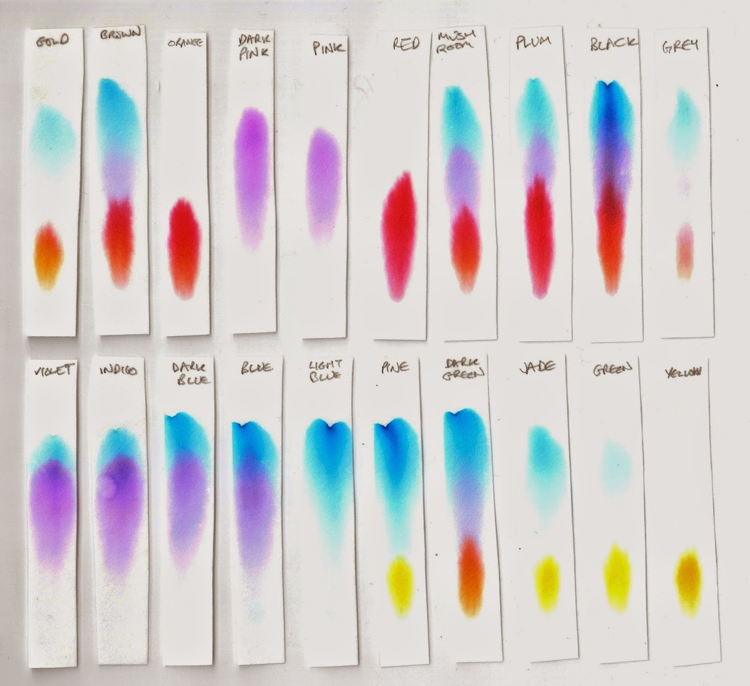
Introduction to Chromatography
The rate of movement of each component depends mainly upon:
How strongly the component adsorbs onto the stationary phase
How readily the compound dissolves mobile phase
Adsorption – adhesion of molecules or substances to the surface of a solid or liquid.

Slide 4
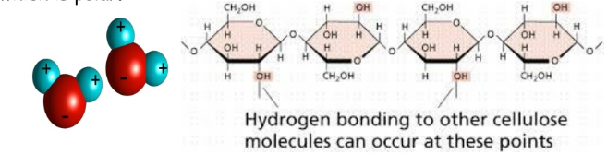
Paper chromatography
Stationary phase: paper (water molecules bound to surface of cellulose)
Mobile phase: a suitable solvent (ranging from water to organic liquids)
The mobile phase moves up the paper due to capillary action (movement of a liquid within the spaces of a porous material)

Slide 5
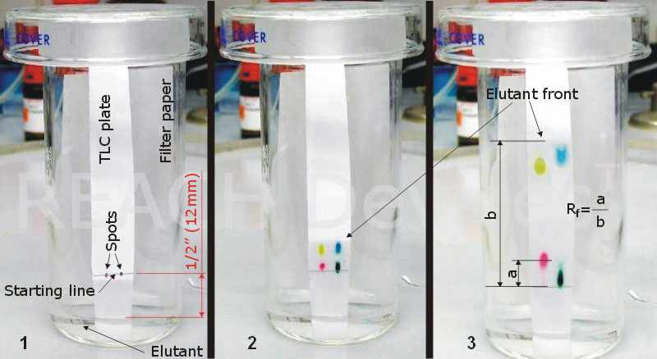
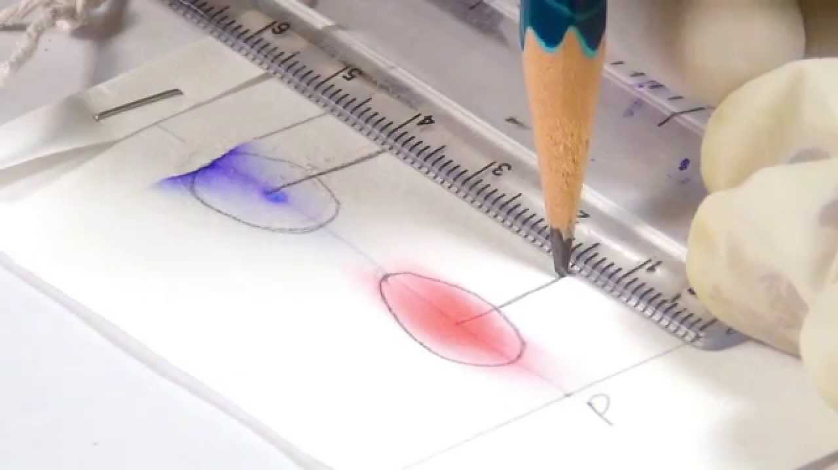
Paper chromatography
Draw a line in pencil about 1 cm from the bottom of the plate (origin line)
Apply the mixture to be separated (e.g. draw a dot with a pen, add a drop of liquid with a pipette)
Gently place the paper in a beaker containing a small amount of solvent, being careful not to let the paper touch the glass sides of the beaker
Wait as the mobile phase is soaked up by the paper, gradually moving upwards
Once the solvent front reaches the top of the paper remove it from the beaker and with a pencil make the solvent front
Detect the components (visible, UV light, ninhydrin etc)
Measure the distance each component travelled and record a R_{f} value for each

Slide 6
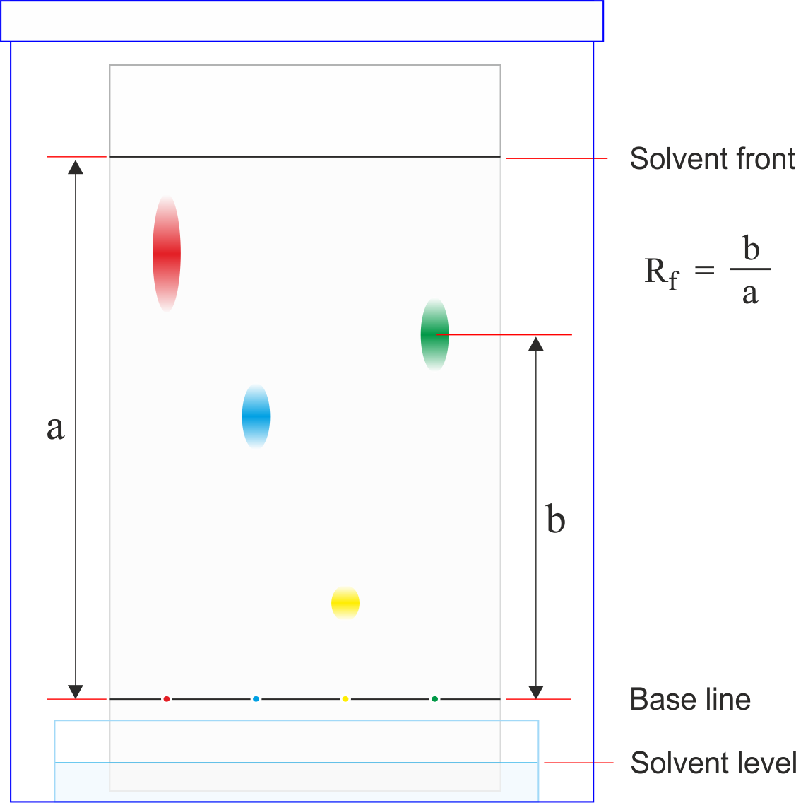
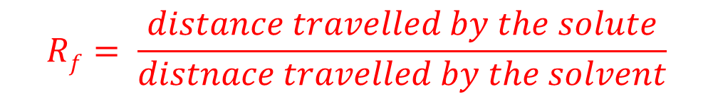
Retardation factor, R_{f}
$$Rf= \frac{distance travelled by the solute}{distnace travelled by the solvent}$$
Rf = 1 means the solute has travelled with the solvent front (extremely high affinity for mobile phase)
Rf = 0 means the solute has not moved at all (extremely high affinity for the stationary phase
Under identical conditions two spots with the same Rf might suggest they are the same compound

Slide 7
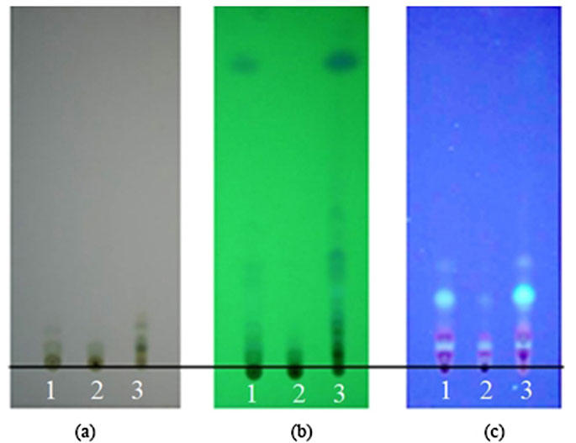
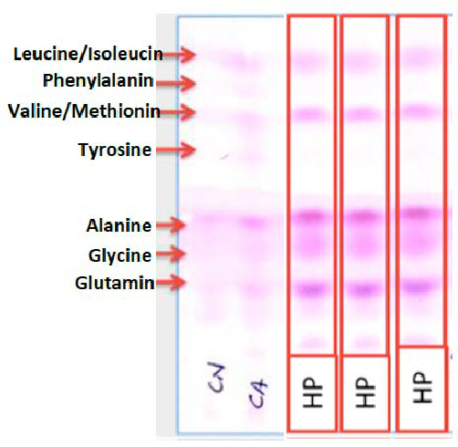
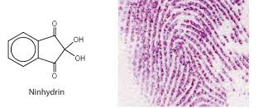
Detection methods
Visual detection (with your eyes) – for coloured substances
Ultraviolet light
Iodine
Ninhydrin – for detecting amino acids or amines, used to detect fingerprints
a) visible, b) UV light at 254 nm, c) UV light at 366 nm

Slide 8
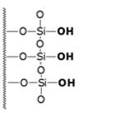
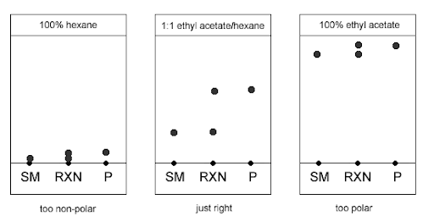
Thin-layer chromatography
Stationary phase: silica (SiO₂) or alumina (Al₂O₃)
Mobile phase: a suitable solvent (organic liquids with range of polarities)
Example of how changing the solvent polarity can effect the chromatogram.

Slide 9
Thin-layer chromatography
Separation with TLC is sharper than with Paper chromatography
TLC is more reliable
Procedure is similar to Paper chromatography except that you put a lid on the beaker to stop the organic solvent from evaporating
The retardation factor depends on the stationary phase, mobile phase and temperature. If two components have the same Rf it can be used as evidence of the two being the same substance (i.e. they might be the same compound)

Slide 10
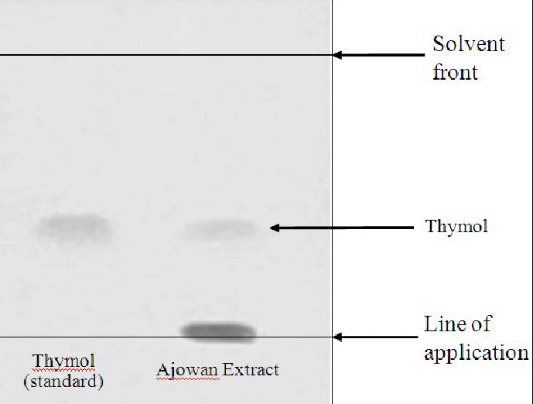
Thin-layer chromatography
Two ways of identifying components
Using standards – use pure samples of known substances as standards for a direct comparison to the unknown sample. This requires all samples to be on the same TLC plate so that the solvent travels the exact same distance
Using Rf values – calculate the Rf value for each, the benefit is the plates can be run separately as it doesn’t matter if the solvent distance changes as we use a ratio

Slide 11
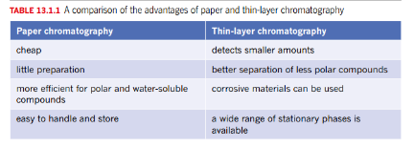
Comparison
TLC – perfect for separating inks, plan extracts, drugs
Although screening tests for drugs using TLC exist, they can give false positives and require a confirmatory test (such as HPLC or GC)

